Slide 1


Final Dissertation
BACHELOR’s DEGREE in COMPUTER SCIENCE
a web graphical user interface for the
packet-loss-concealment testbench tool
Student Stefano Dallona | Supervisor Prof. Luca Turchet | Co-Supervisor Ing. Luca Vignati
Notes:
Good morning / afternoon to everyone, first of all I would like to thank all the committee members for attending the discussion of my thesis work.
My name is Stefano Dallona, I'm a student of the Bachelor's Degree in Computer Science and for the entire duration of my studies I’ve worked full-time.
The title of my thesis is: "A Web Graphical User Interface for the Packet-Loss-Concealment Testbench Tool". My work was supervised by professor Turchet and by Luca Vignati.
What really attracted me about this thesis was that, being complementary to a Ph.D research carried out by Luca Vignati, it had an immediate applicability and the topic was totally new to me and therefore very challenging.

Slide 2

Introduction
1
Context
PLC Testbench, a tool for the comparison of Packet Loss Concealing algorithms
2
Problems
Interaction only possible at code level in an IDE
Output information not integrated
3
Solution
Development of a graphical user interface
Notes:
The context in which the idea of this thesis was born is the PLC Testbench, which is a tool to compare the effectiveness of different Packet-Loss-Concealment algorithms.
PLC algorithms try to make packet loss in audio streams unperceivable by reconstructing the lost portions of the signal to provide acceptable quality even on lossy connections.
The biggest problems with the PLC Testbench were that:
the only way to interact with the tool was by directly editing and executing the code in an IDE;
the analysis of the outputs was a bit cumbersome and inefficient because the output information was not integrated.
The development of a Graphical User Interface was seen as a solution to these problems.

Slide 3

Purpose of the Thesis
Develop a Graphical User Interface for the PLC Testbench tool
in order to make
QUALITATIVE and QUANTITATIVE
comparison of PLC algorithms
EASY, EFFECTIVE and EFFICIENT
Notes:
The purpose of this thesis work was therefore developing a GUI for the PLC Testbench to support the qualitative and quantitative comparison of PLC algorithms by making the interaction with the tool easy, effective, and efficient.
Qualitative comparison mainly consists in visually comparing waveforms and spectrograms, and in listening to portions of the original and reconstructed audio files.
Quantitative comparison is essentially based on the figures from the metrics calculated by the program on each audio file.

Slide 4
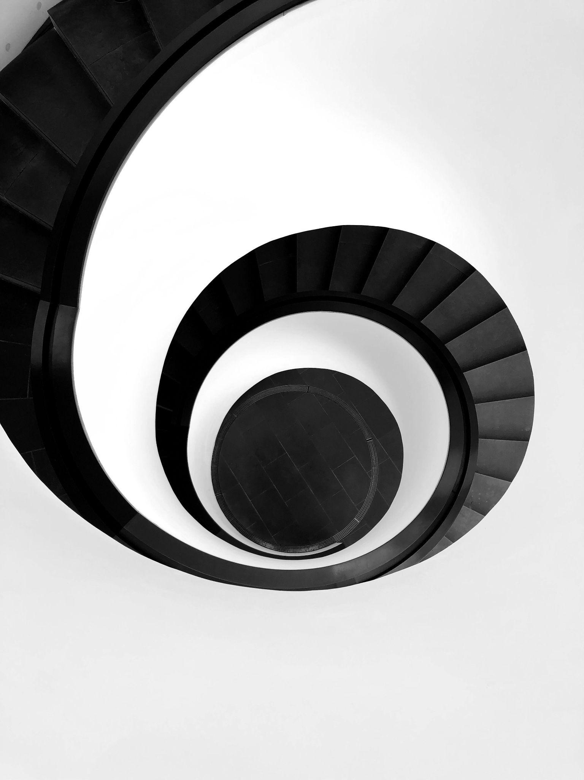
Methodology
Iterative agile development process
to
shorten release cycles / fast feedback
minimize risk of useless development
1
2
N
Design
Design
Design
…
Testing
Develop
Testing
Develop
Testing
Develop
Notes:
From a methodological perspective, it was decided to adopt an iterative agile development process based on Kanban because of its simplicity and flexibility.
The process essentially consisted of short cycles of design, develop and testing phases.
The limited duration of the iterations allowed keeping the focus on small and clear objectives and getting fast feedback, thus minimizing the risk of wasting time developing useless functions.

Slide 5





Technologies
React frontend widgets | Flask backend RESTful API | Docker packaging & containerization | Circle CI build & deploy
Notes:
From a technological perspective it was decided to implement the PLC Testbench’s GUI through a Web application, because of the advantages offered in terms of ease of distribution, scalability and accessibility.
From an architectural point of view the web application was split into 2 layers: a frontend developed in JavaScript and based on React framework, and a backend, developed in Python with the help of the Flask framework.
Bundling and distribution were addressed by containerizing the application as a Docker image, while for build and deploy I leveraged the pipelines as code solution offered by Circle CI’s cloud platform.

Slide 6
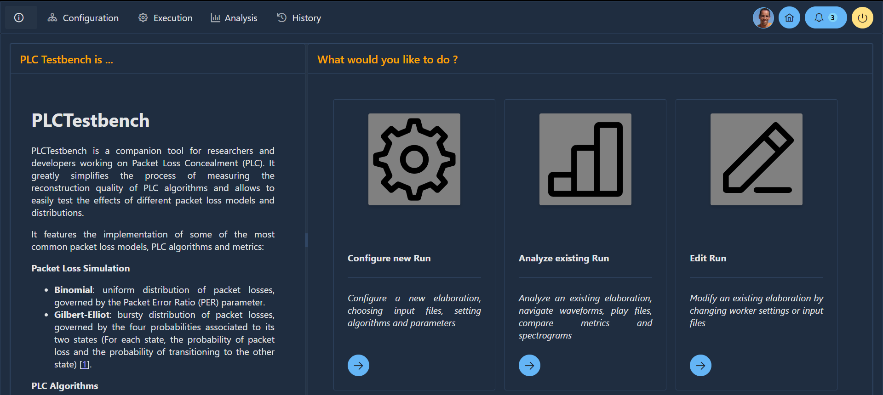
GUI - Landing Page
Notes:
Now time has come to have a look at the application interface.
This is the landing page which addresses two main purposes. The first one is helping the user to develop a proper mental model of the software. To obtain this, a short help page about PLC-related concepts and what the application can do is displayed on the left. The second objective of this page is putting the user in condition to start using the testbench immediately. To achieve this, a list of the most relevant operations supported by the application is displayed on the right, with a direct entry point to the functions.

Slide 7
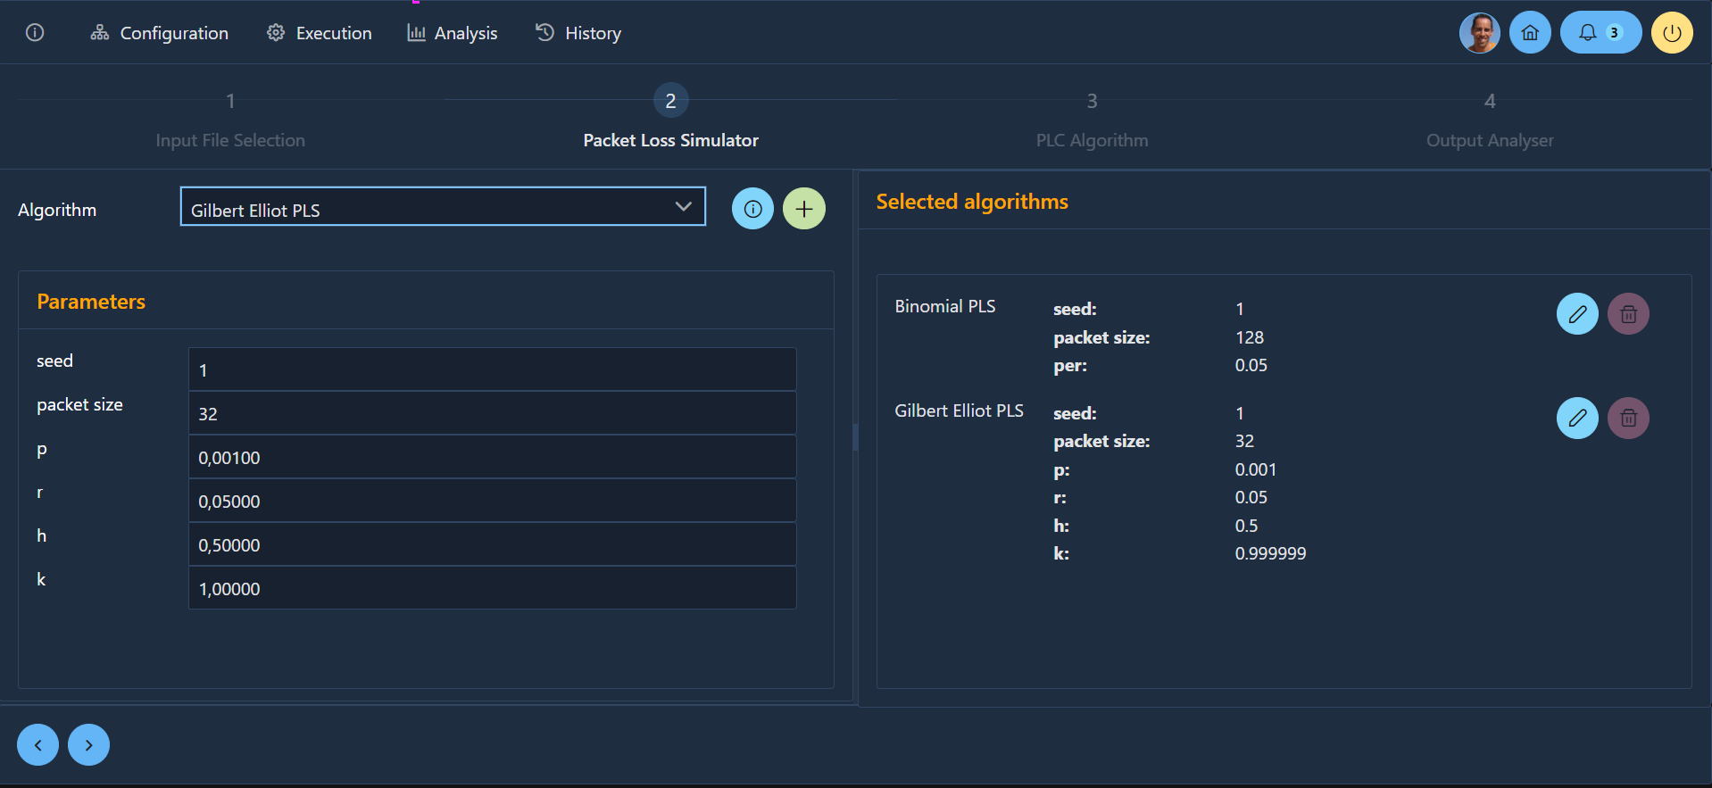
GUI - Configuration Module
Notes:
This screen instead is intended to guide the user through the collection of the input data to configure an elaboration. Design in this case was focused on three targets:
fast and effective interaction: pursued by providing sensibile defaults for the settings and keyboard shortcuts;
clarity: pursued by splitting the configuration process into multiple sequential steps, each focused on a single aspect;
adaptability: achieved by implementing dynamic discovery of the available algorithms and their settings, thus supporting testbench extensions without requiring any change to the code.

Slide 8
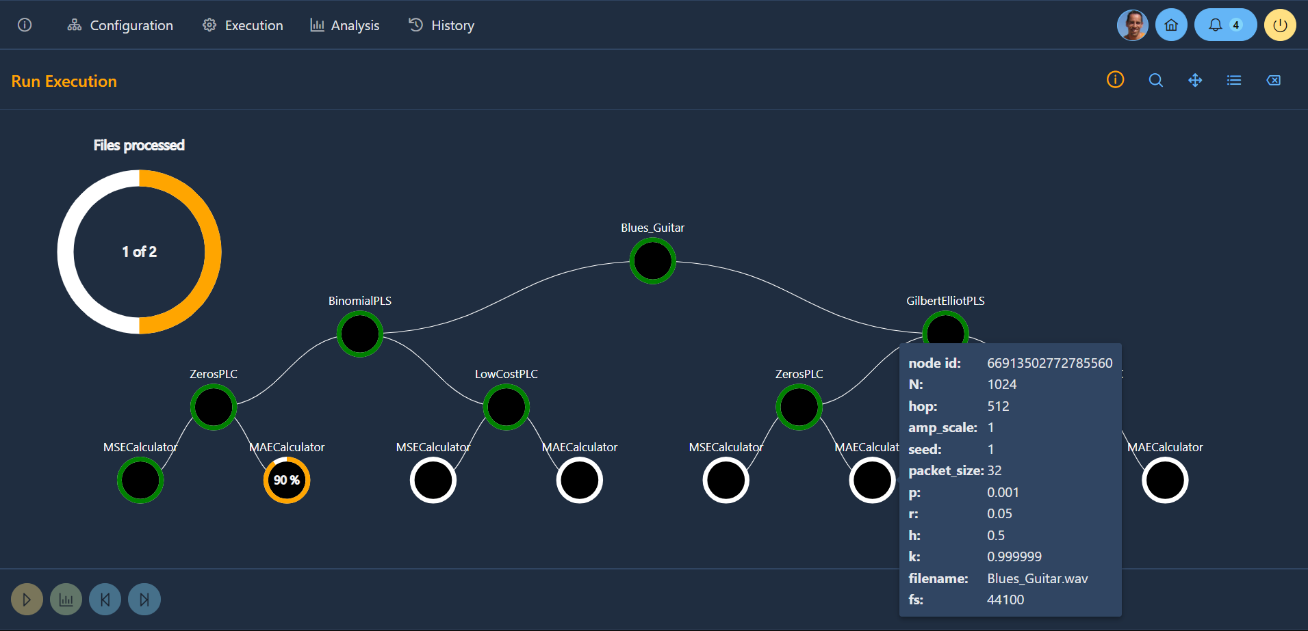
GUI - Execution Module
Notes:
A PLC Testbench elaboration can be represented as a forest of trees, where each tree corresponds to the processing of a single input file.
Since an elaboration can in some cases take a considerable amount of time, having the possibility to monitor progress was essential.
Being the structure of the elaboration identical for all the input files it was decided to display progress at two different levels of detail: overall progress and progress within a single file processing. The settings of each elaboration step can be inspected by placing the mouse pointer over the corresponding node.

Slide 9
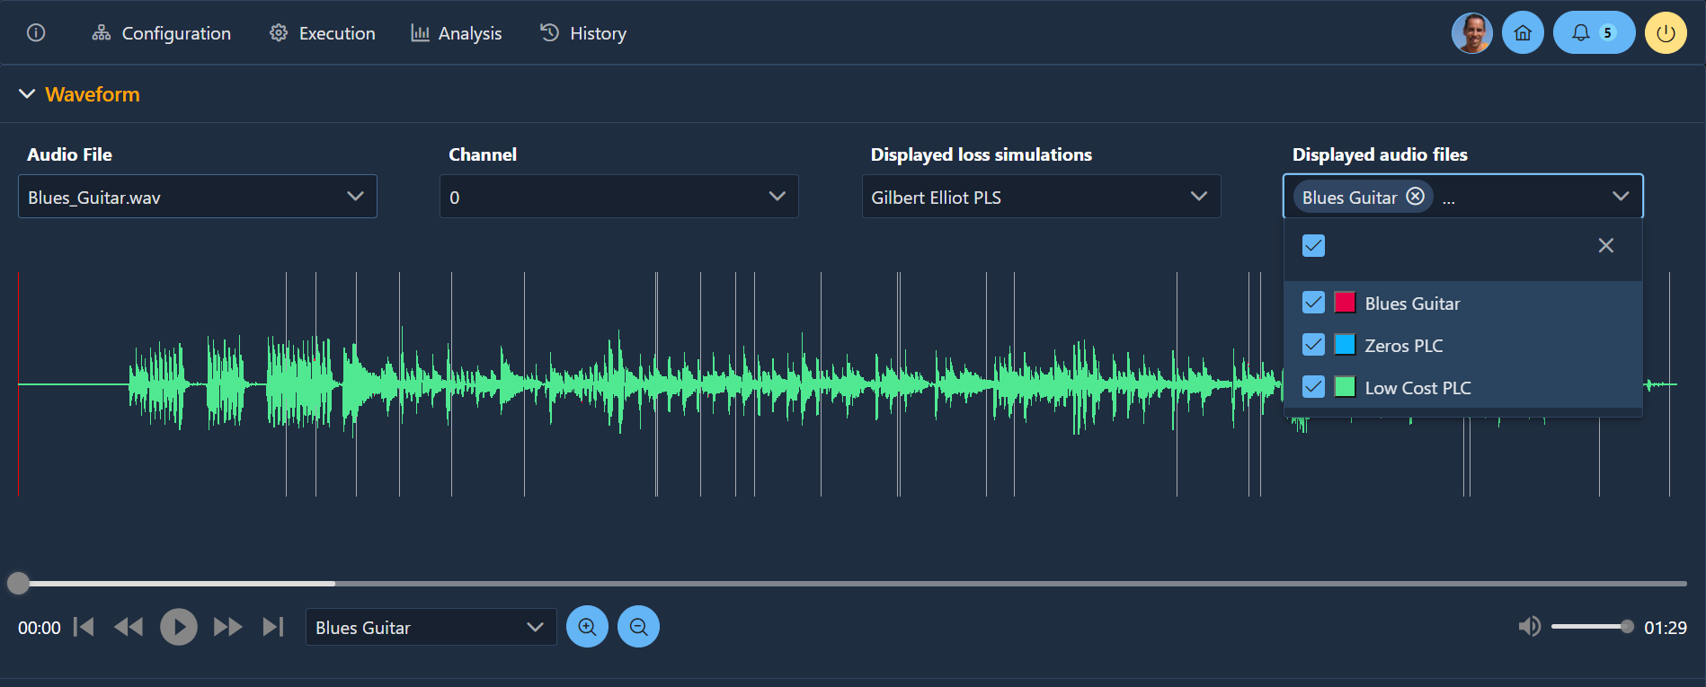
GUI - Analysis Module - 1
Notes:
In the analysis module the waveforms of all the versions of a given input file are displayed on the same chart, together with the lost packets’ regions.
Each waveform can be shown or hidden by activating or deactivating the corresponding checkbox in the selected audio files dropdown.
Each audio file can be played by the playback controls and bar below the waveforms chart, to evaluate the perceived quality of the reconstruction.
By dragging the mouse pointer over the chart it is possible to zoom-in any portion of the file. The zoom operation can be repeated until the desired level of detail is reached.

Slide 10
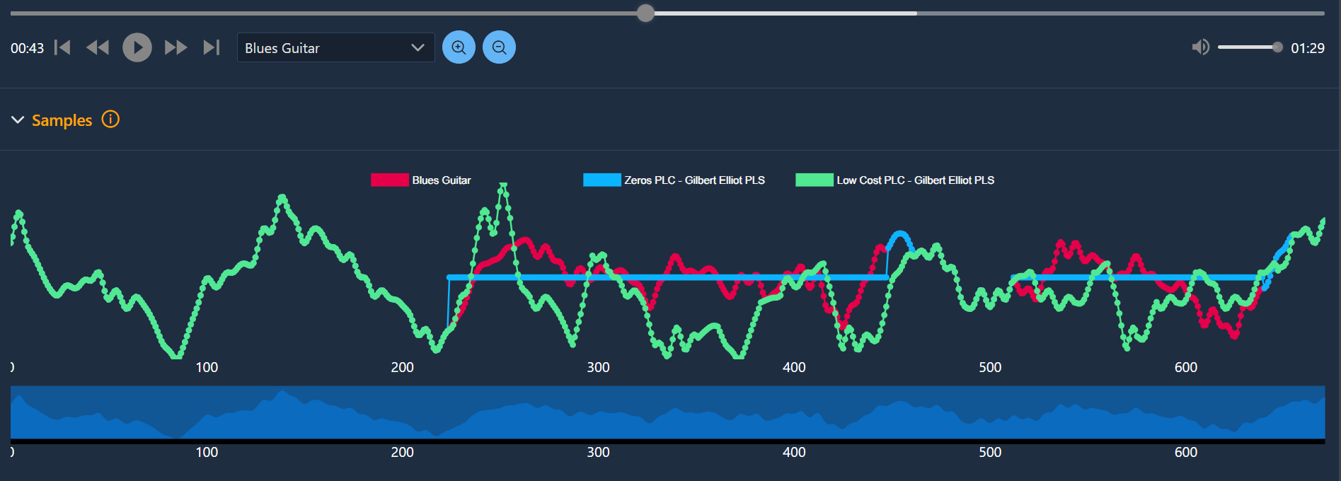
GUI - Analysis Module - 2
Notes:
When clicking on a lost packets region in the “Waveform” view, the detailed waveforms of all the audio signal’s reconstructions are displayed in the “Samples” view for a slightly wider area surrounding the lost packets. Each waveform can be shown or hidden by clicking on the corresponding item in the legend.
Zoom-in and zoom-out are supported by dragging the handles in the bar below the chart. At maximum zoom level single audio signal’s samples can be discriminated.
The more the original and the reconstructed signals are overlappable, the more the reconstruction can be considered accurate.

Slide 11
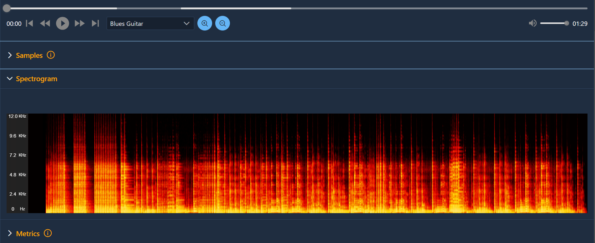
GUI - Analysis Module - 3
Notes:
For each audio file a spectrograms can be displayed, representing the composition of the audio signal over time as a color map, where brighter colors correspond to greater intensity of the corresponding frequencies.

Slide 12
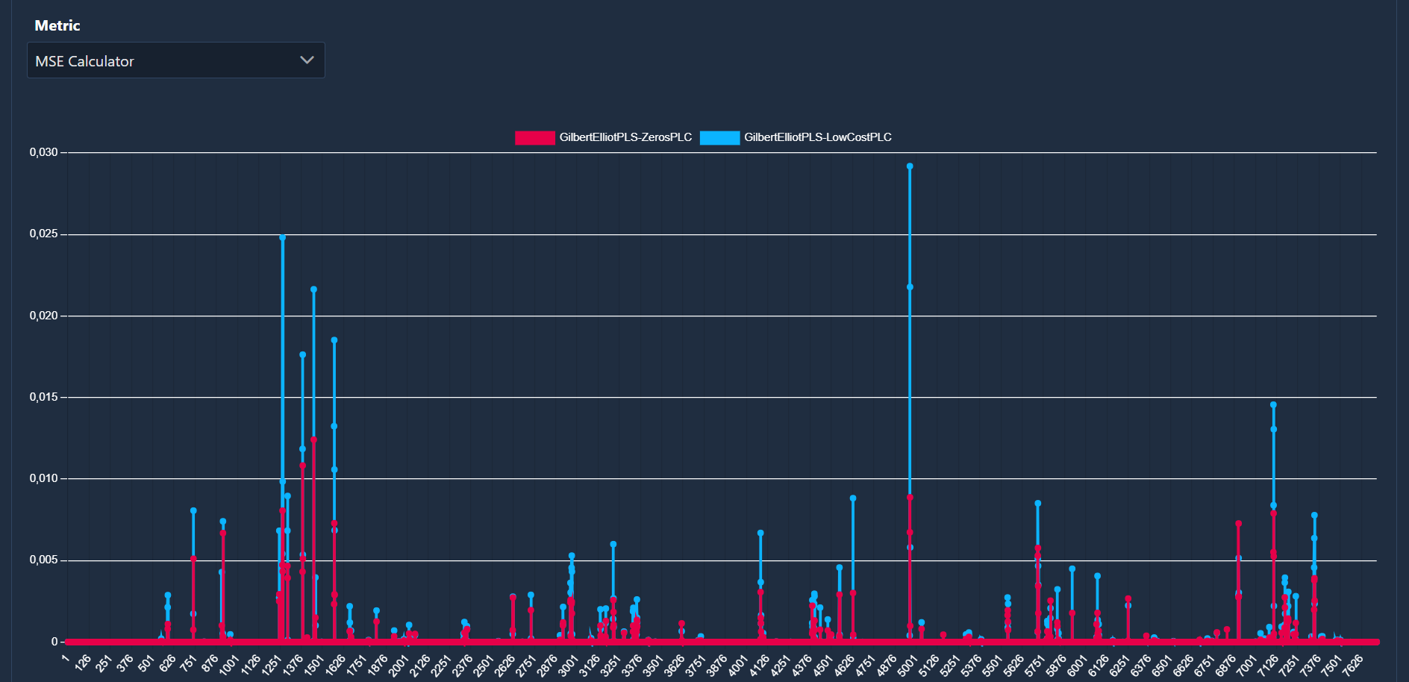
GUI - Analysis Module - 4
Notes:
Output metrics are calculated on each original and reconstructed audio file. They can be grouped into two categories: linear metrics, producing a time series for each audio file, and scalar metrics, producing a single value for each audio file.
The data to be displayed can be customized by clicking on the legend items.

Slide 13
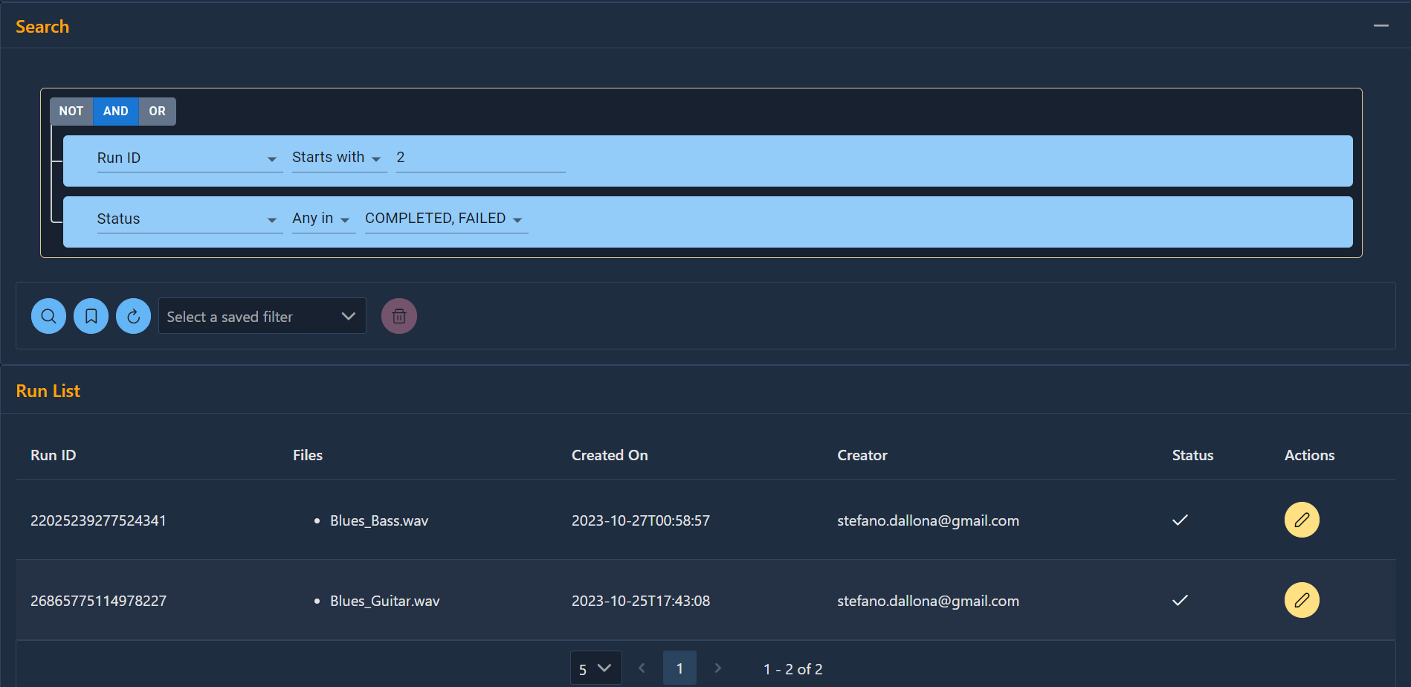
GUI - Search Module
Notes:
The search module allows the user to navigate through the list of the elaborations or to build, save and re-execute specific queries. Queries can be built visually by combining multiple conditions using logical operators. Each condition can be based on any field of the elaboration or on any setting of the referenced algorithms.

Slide 14

Results
Benefits brought to the PLC Testbench tool
Easier installation
Less steep learning curve
Debug & validation
Scalability
Improved analysis
capability
Usage extension
Notes:
The most relevant benefits brought to the PLC Testbench tool by this thesis work can be summarized as follows:
a thorough debug and validation of the testbench was carried out during of the project;
the analysis capabilities of the tool have been extended and improved in terms of quantity and quality of the information;
tool installation has been made easier by hiding the complexity in the build process of the docker image;
the application has been made more scalable by making distributed deployment possible;
the tool can now be used also by users with no expertise in Python programming.

Slide 15
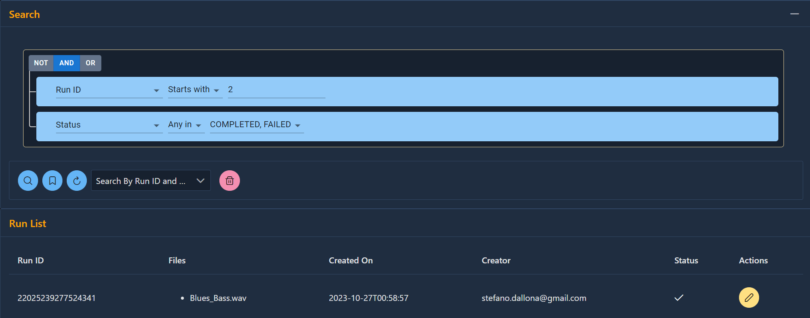
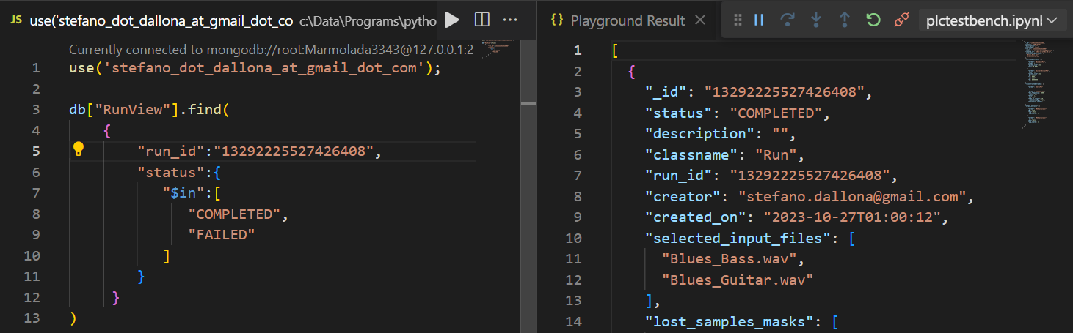
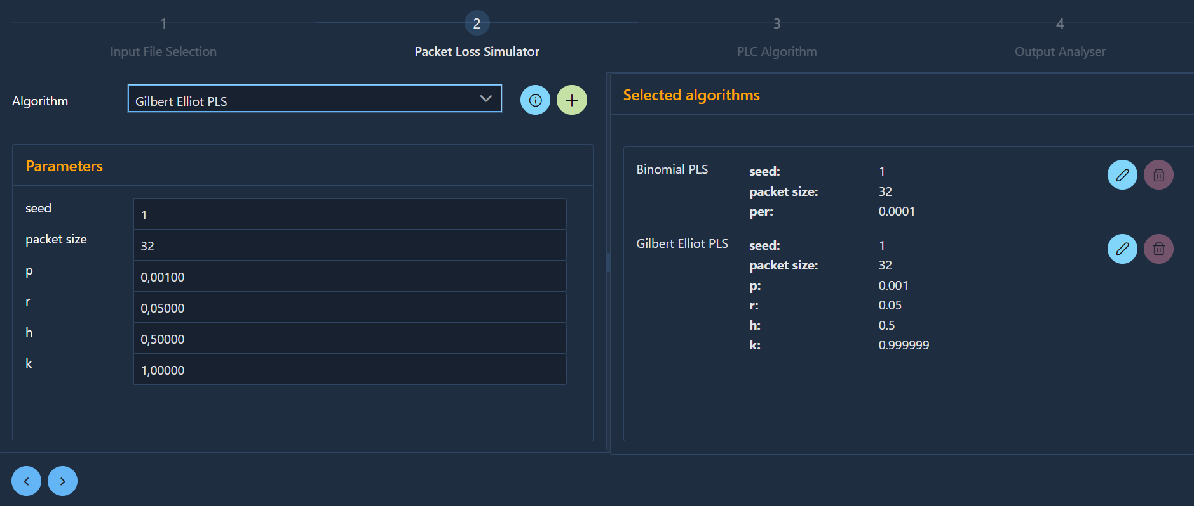
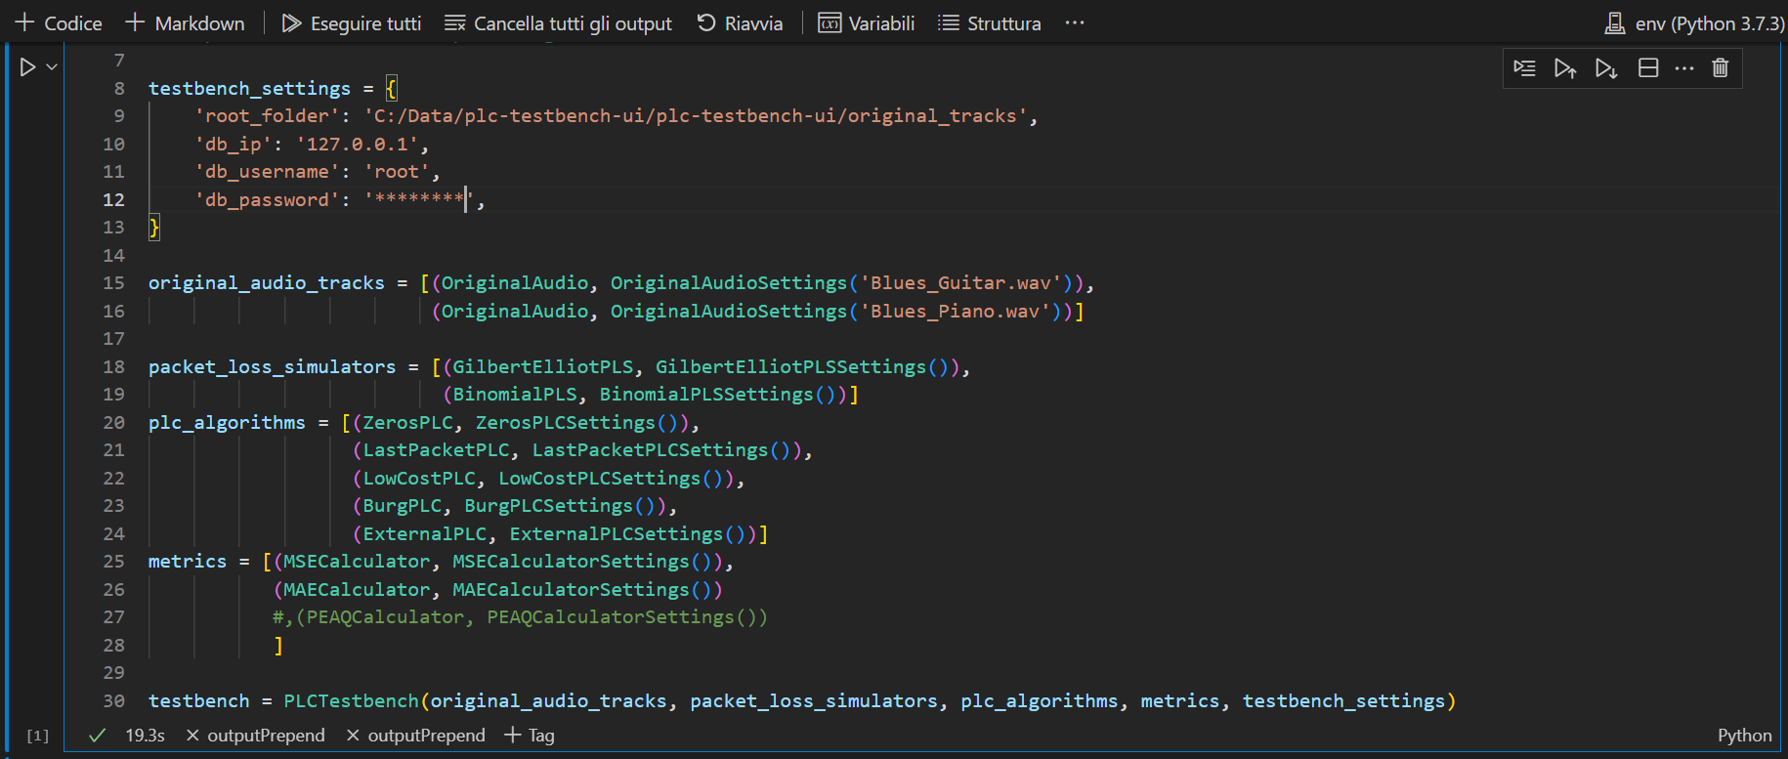
GUI vs Native Interaction - 1
Notes:
This slide shows a visual comparison of how some operations are handled in the web GUI versus how they are carried out through the native testbench interface.
On the left we can see how the GUI supports visually building a queries to find specific elaborations or configuring new ones. On the right, in the native interaction the same operations have to be performed at programming level.

Slide 16
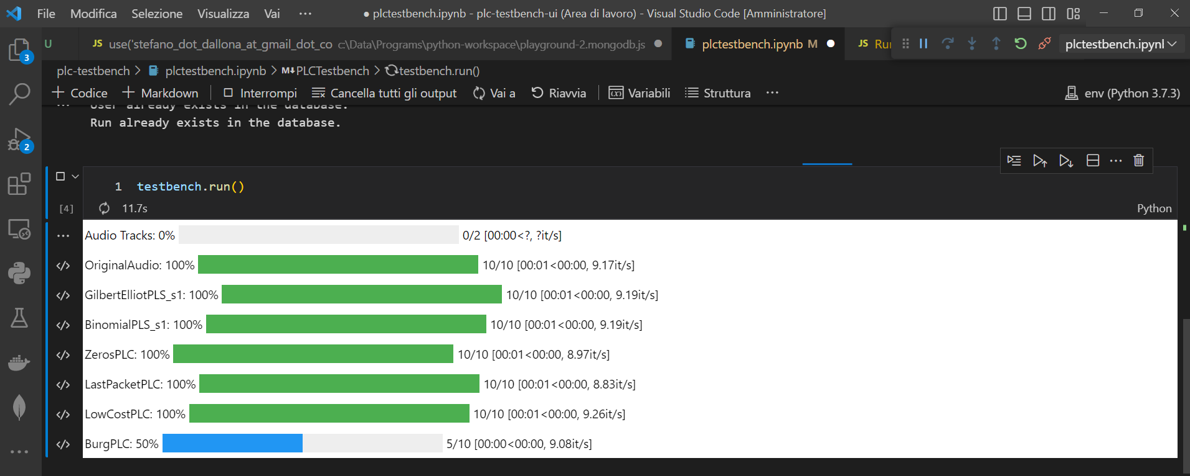
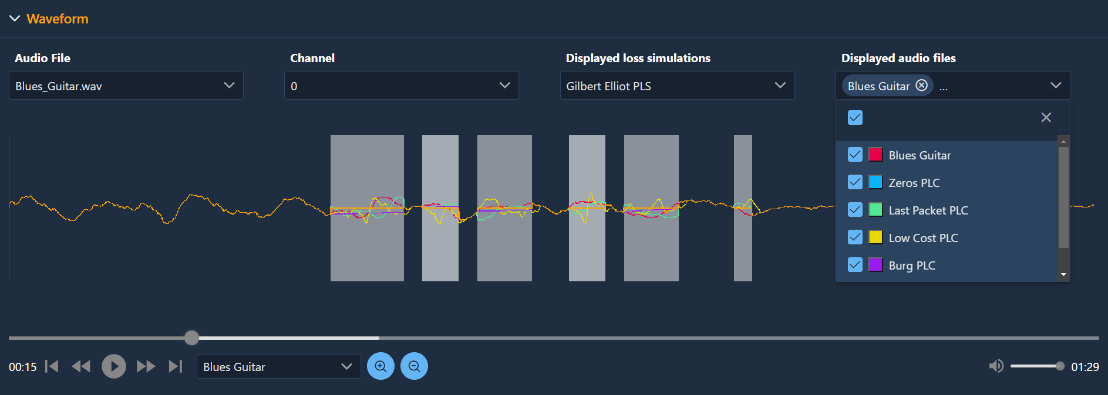
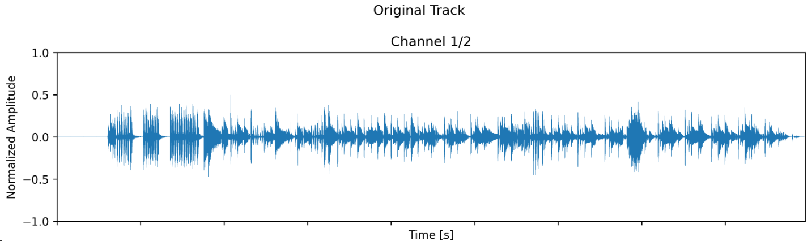
GUI vs Native Interaction - 2
Notes:
Here the same comparison Is displayed for progress monitoring and result analysis use cases.
Again the web GUI provides a more convenient and effective interaction by presenting output information in a more detailed and integrated way. For exanple only in the GUI the hierarchical structure of the elaboration can be recognized and the lost packet regions are overlapped to waveforms.

Slide 17

Future Work
A few ideas
Extensive validation with users (*)
Support for additionals audio formats
Exposing logs
Search functions on output results
UI Themes
Support for additional languages
User collaboration use cases
Additional authentication & authorization methods
Data export
(*)
A first preliminary but very positive feedback has been received from experts at the IS2 2023 Conference in Pisa
Notes:
Despite being fully operational and exposing all the current functions of the underlying PLC Testbench, the web GUI still has a lot of room for improvement.
In this slide I tried to provide some indications on possible future enhancement areas, like:
Extensive validation with users;
Support for additionals audio formats;
Exposing logs;
Search functions on output results;
Management of UI Themes;
Support for additional languages;
User collaboration use cases;
Additional authentication & authorization methods;
Data export.

Slide 18

Conclusions
PLC Testbench
Native interaction
Web GUI
- limited and raw visual output
- no output integration
- programming-level interaction
- installation complexity
- sophisticated visual output
- highly integrated output
- graphical interaction
- installation ease
Notes:
Finally this slide summarizes the major achievements of this thesis work by highlighting the most critical limitations of the native PLC Testbench's interface and how they were addressed and overcome in the web GUI.
For example:
limited and raw output has been replaced by a sophisticated dashboard where information is highly integrated;
from the programming level the interaction has been turned into graphical;
installation complexity has been completely hidden.

Slide 19




References
 | GitHub repository of the project https://github.com/cimil/plc-testbench public access
 | Docker image of the project https://hub.docker.com/r/cimil/plc-testbench-ui public access
 | Paper presented at the IS2 2023 in Pisa 4th International Symposium on the Internet of Sounds https://drive.google.com/file/d/1kFY9Hj-G7mWJP7U3CpPZf9TR95M5tQGV/view?usp=drive_link restricted access
Notes:
The results of this thesis work are publicly available in the form of source code at the GitHub URL mentioned in the slide or as a pre-built docker image at the indicated DockerHub URL.
A paper about the jointed work of Luca Vignati and me for the respective Thesis was presented at the 4th International Symposium on the Internet of Sounds, held in Pisa on the 26-27th of October 2023 and will soon be available in the proceedings of the conference.

Slide 20

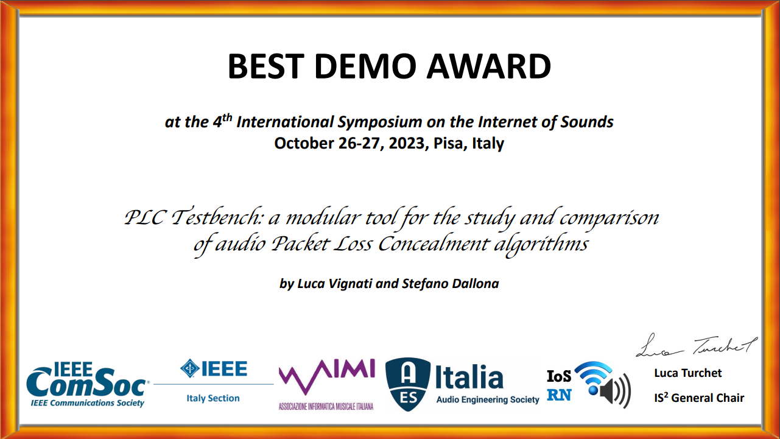
Prizes
Notes:
During the conference in Pisa the software was presented to a team of experts and got a very positive feedback.
At the end of the conference Vignati and me had the great honor to be prized with the “Best Demo Award”.
Thank you so much for your attention.
Now I am at your disposal in case there are any questions.

Slide 21

Acknowledgements
Thanks to
Prof. Luca Turchet
Ing. Luca Vignati
for the invaluable feedback
and support provided

